Slide 1
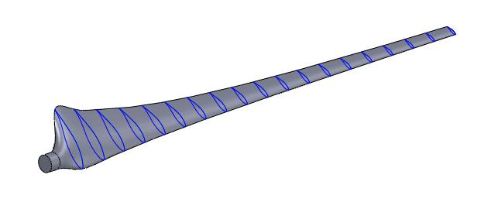
[University of Central Lancashire]

Slide 2
Topics
Blade design according to Betz
Blade design according to Schmitz
Blade design for recent variable speed turbines
Implementation in NREL codes
Summary
No reproduction, publication or dissemination of this material is authorized, except with written consent of the author.
Oldenburg, May 2016 Prof. Dr. Martin Kühn

Slide 3
Overview
Blade design (Betz)
Blade design (Schmitz)
Implementation in NREL codes
Blade design for recent variable speed turbines

Slide 4
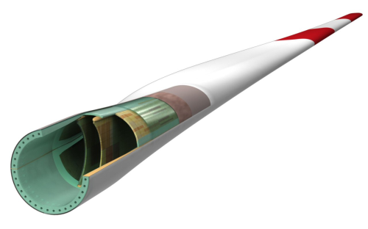
The design of a typical wind turbine blade.
Note:
We are dealing only with the aerodynamic blade design here! In reality, aerodynamic design and structural design and production and logistics are strongly interrelated design aspects.
http://www.reinforcedplastics.com/view/3144/curing-agents-improve-rotor-production/ (accessed 14 May 2014)

Slide 5
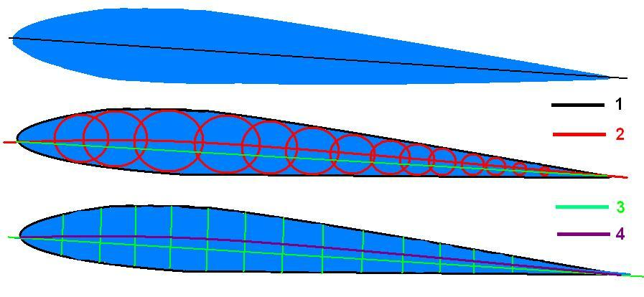
1. Blade design according to Betz NACA profile series
National Advisory Committee for Aeronautics
Public available blade profile data
Different families of profiles, defined by number of digits
More information can be found in the internet

Slide 6
Find optimal lift coefficent
Optimal lift coefficient is defined as maximum of the lift-to-drag ratio
Still good lift-to-drag ratio at higher angles of attack
Different C_{p} can be desired if max. lift-to-drag ratio leads to smaller C_{p}’s
Larger C_{p} → smaller blade chord
Blade design (Betz)
Blade design (Schmitz)
Implementation in NREL codes

Slide 7
Determination of blade planform t(r) acc. to Betz, i.e. excluding wake rotation
Objective: optimum local wind speed reduction
Assumption: lift >> drag at design point
power from blade element (BE) theory = max. power
(Betz)
inflow, V₂
blade speed, Ωr
inflow angle, α
Relative speed, V_{rel}
rotor axis
lift
peripheral
force
thrust
(at blade)
dr
rotor plane
r

Slide 8
Determination of blade twist
Objective: optimum local wind speed reduction
Assumption: lift >> drag at design point
Power from blade element theory = max. power (Betz)
!
rotor axis
v_{rel}
Ω
α_{A}
A(r)
α_{twist}
v₂
rotational plane
Ω r
rotor chord
Blade design (Betz)
Blade design (Schmitz)
Implementation in NREL codes

Slide 9
Formula for chord and twist acc. to Betz
Blade design (Betz)
Blade design (Schmitz)
Implementation in NREL codes

Slide 10
2. Blade design according to Schmitz, i.e. including wake rotation

Slide 11
Dimensionless planform: Betz vs. Schmitz:

Slide 12
Blade twist: Betz vs. Schmitz

Slide 13
Overview
Blade design (Betz)
Blade design (Schmitz)
Implementation in NREL codes
Blade design for recent variable speed turbines

Slide 14
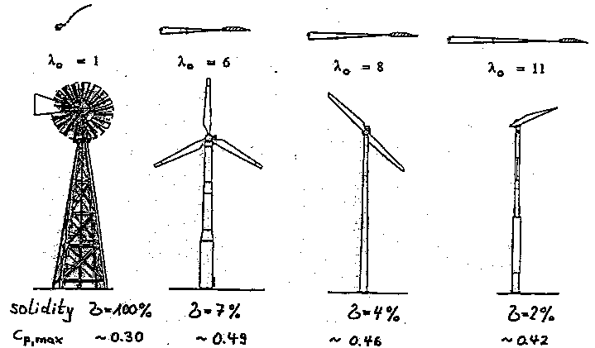
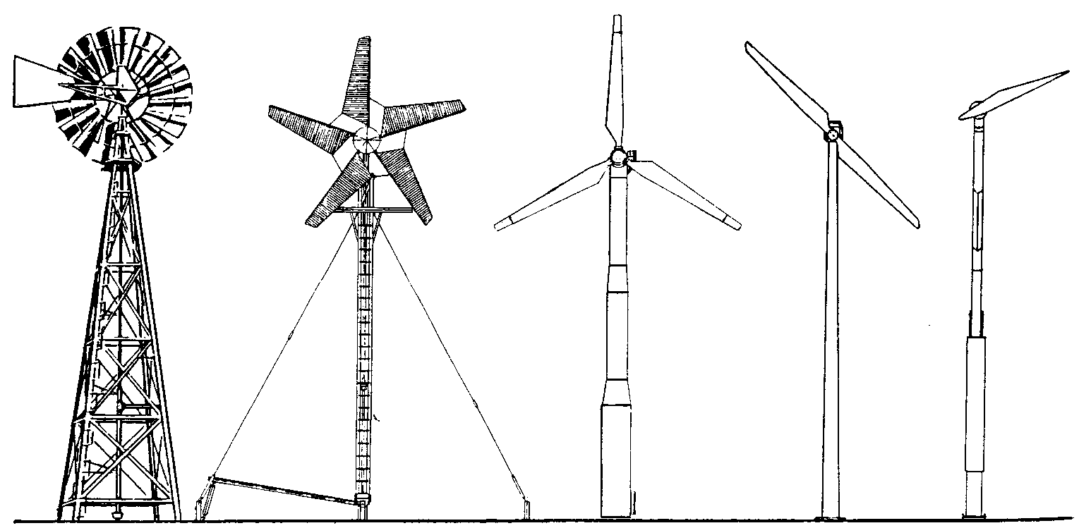
Traditional choice of design tip speed ratio λ_{D} for turbine with (almost) constant rotor speed
λ_{D} ≈ 1 : Wind energy converter of low rotational speed (prime mover)
λ_{D} > 5 : Wind energy converter of high rotational speed (turbine)
[fig. Gasch]
λ_{D}=1
λ_{D}=2
λ_{D}=6
λ_{D}=8
λ_{D}=11

Slide 15
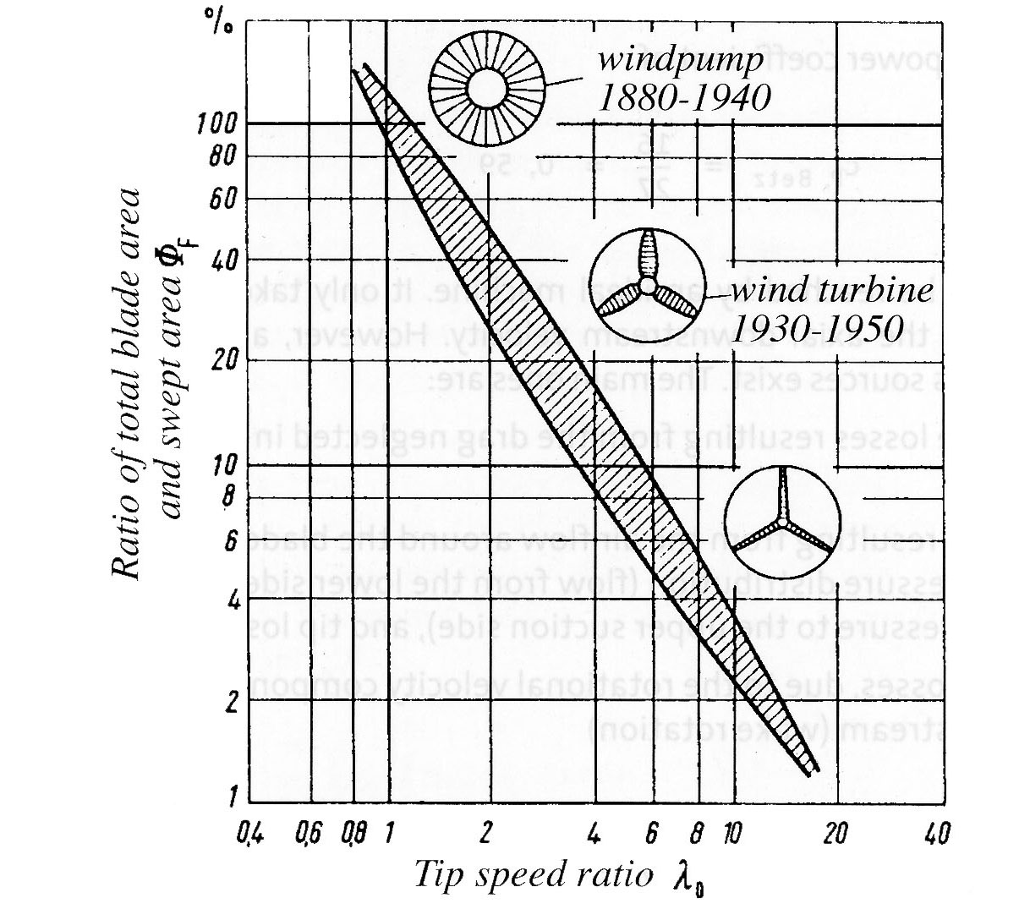
(Dimensionless) rotor solidity σ Ratio of rotor surface to swept rotor area
N
with:
average chord length
turbine with low tip speed ratio
(N = 20, λ_{D} = 1): σ = 100 %
turbine with low high tip speed ratio
(N = 2, λ_{D} = 8): σ = 4 %
[fig. Gasch]

Slide 16
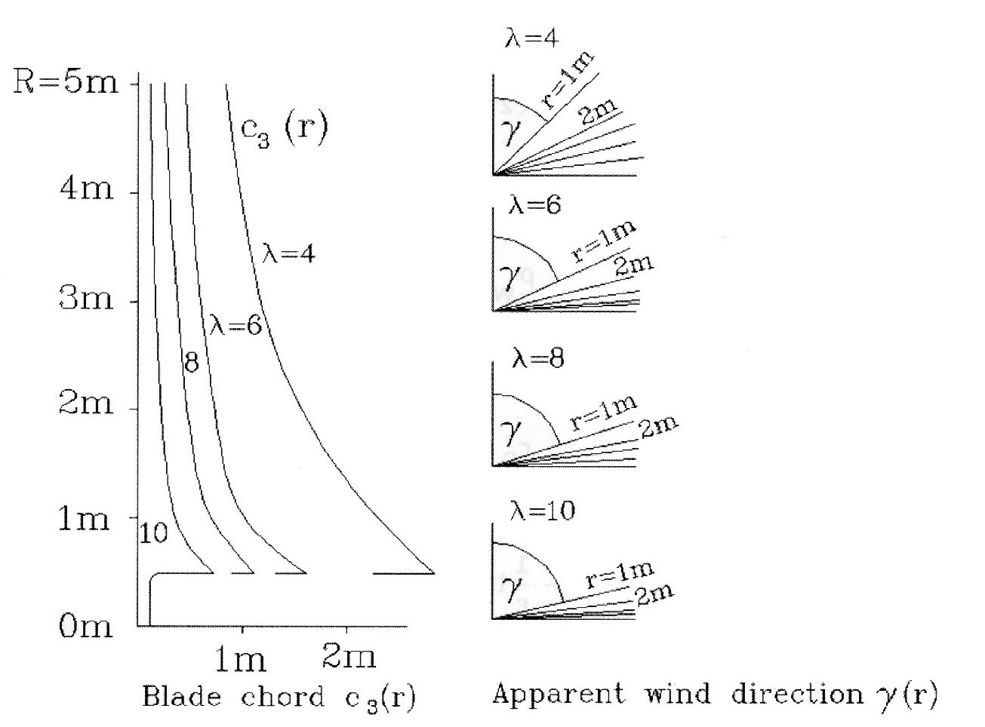
Distribution of blade chord and twist for different design tip speed ratio λ_{D}
Note: In the diagram λ is referring to the design tip speed ratio λ_{D}
[fig. Gasch]

Slide 17
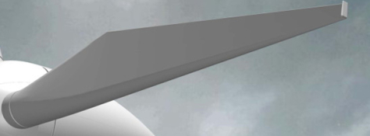
4. Blade design for recent variable speed turbines
Example: Development of Enercon blade designs
[Source: www.eyeofthefish.org]
[Source: Gasch, 2015]

Slide 18
Power limitation & control
Region 1 Region 2
Elec. power
below V_{cut-in} (approx. 3 – 4 m/s) :
idling, large pitch angle
Region 1: betw. V_{cut-in} and V_{rated} (approx. 11 – 12 m/s) :
production at partial load
pitch angle constant at 0º
variable speed proportional to wind
turbine operating at aerodyn. optimum
Region 2: betw. V_{rated} and V_{cut-out} (approx. 20 - 25 m/s) :
production at full load
speed on average constant
pitch angle increases with wind
dynamic control of speed (fast) and pitch
(slower) to reduce power and load
variations
above V_{cut-out} : idling, large pitch angle
λ = λ_{opt}
λ < λ_{opt}
λ « λ_{opt}
n_{nenn}
Rotor speed
v_{cut-in}
v_{rated}
v_{cut-out}
v_{cut-out}
85º
Pitch angle
65º
25º
11 - 13m/s
20-25m/s
0º
4m/s
Wind speed
Standstill Start Partial load Full load Cut-out
Idling No pitching Pitch control Idling
var. speed n_{rated} ±10%

Slide 19
Power, C_{p} and C_{T} curves: E-101 3050 kW
var. pitch
var. speed

Slide 20
Different blade design philosophies of var. speed WT
Exp 1: Very traditional design
=> tapered chord, moderate design tip speed => relative high solidity
Exp. 2: Enercon E-101 3,050 kW (series production: Aug 2011)
=> slender blade, design for var. rotor speed, λ_{D} ≈ 7,7
Exp. 3: Enercon E-115 3,000 kW (series production: mid 2014)
=> very slender blade, design for var. rotor speed, λ_{D} ≈ 9,5
[Source: www.eyeofthefish.org]
[Source: Enercon Windblatt 04/2012, p. 14]

Slide 21
Power curves for different spec. rating (W/m²)
285 m²
381m²
572 m²
583 m²

Slide 22
Examples of different industrial design approaches for modern slender blades
80% Schmitz design [Gasch, 2015]
Design blade for common λ_{D} value
Reduce the chord length to 80%
Compute C_{p}-λ, C_{m}-λ and C_{T}-λ curves with BEM code for given blade design
Determine optimum λ , which will be higher than initial λ_{D}
Design for high λ_{D} in the variable speed range
Design blade directly for higher λ_{D}
λ _{and} hence C_{p} will decrease significantly in the constant rotor speed range in the upper partial load regime
Internal company know-how and procedures
…

Slide 23
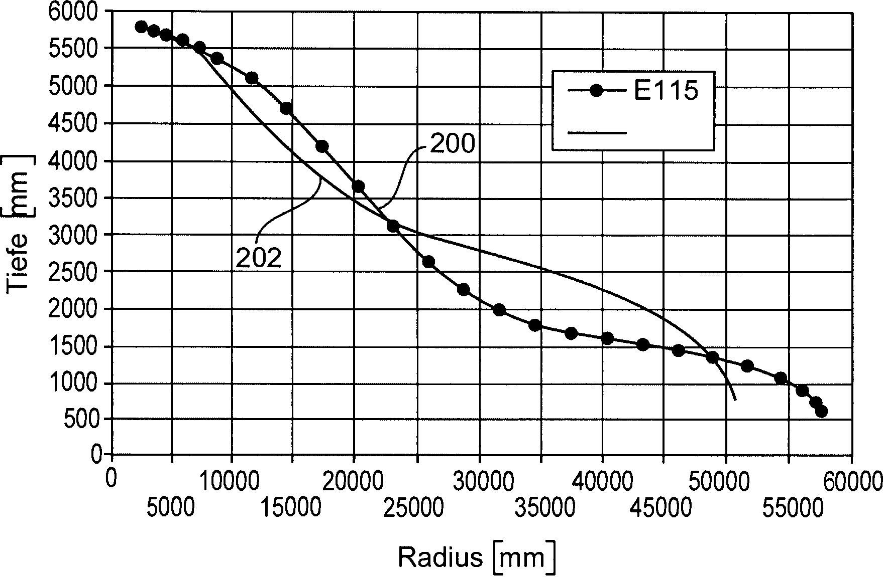
Different blade design philosophies of var. speed WT
Exp. 2: Enercon E-101 3,050 kW (series production: Aug 2011)
=> slender blade, design for var. rotor speed, λ_{D} ≈ 7,7
Exp. 3: Enercon E-115 3,000 kW (series production: mid 2014)
=> very slender blade, design for var. rotor speed, λ_{D} ≈ 9,5
[Source: Patent »Rotorblatt einer Windenergieanlage«
DE 102012206109 B3]

Slide 24
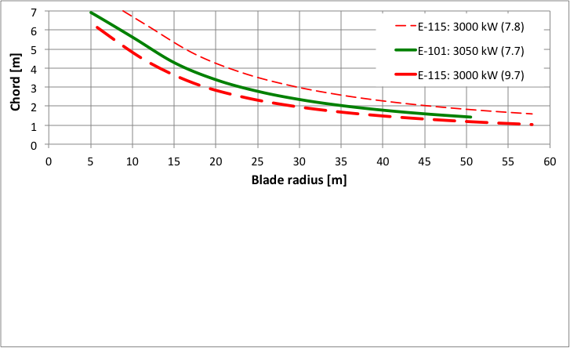
Schmitz design for different λ_{D}
At constant λ_{D} chord is proportional to R and 1 / (r/R)
=> larger blades require more chord (see E-101 λ_{D}= 7.7 vs. E-115 λ_{D}= 7.8)
Increase of λ_{D} reduces chord proportional to 1 / (λ_{D})²
=> slender blade with high λ_{D} (see E-101 λ_{D}= 7.7 vs. E-115 λ_{D}= 9.7)
Increase of design lift coefficient linearly reduced chord
=> C_{l,d} > 1 might cause problems at turbulent sites or with rough airfoils

Slide 25
Power and λ against wind speed
var. speed range
Enercon E-115
(TSR=9.7)
var. speed range
Enercon E-101
(TSR=7.7)
E-115 (77,5 m/s) maintains almost same maximum tip speed as E-101 (76,7 m/s)
=> variable rotor speed only a low and medium partial load range until max. tip speed is reached

Slide 26
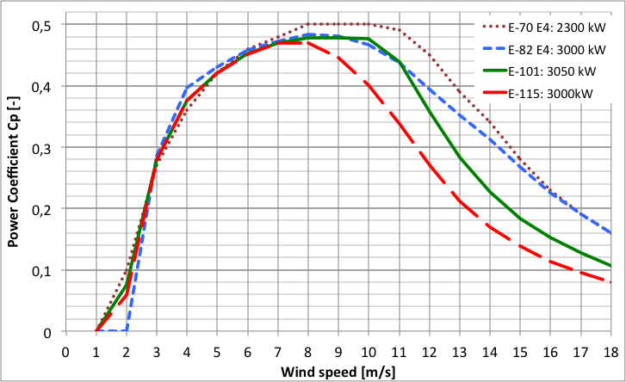
Penalty on power coefficient for λ < λ_{D}
var. speed range: E-115
var. speed range: E-101
var. speed range: E-70 E4

Slide 27
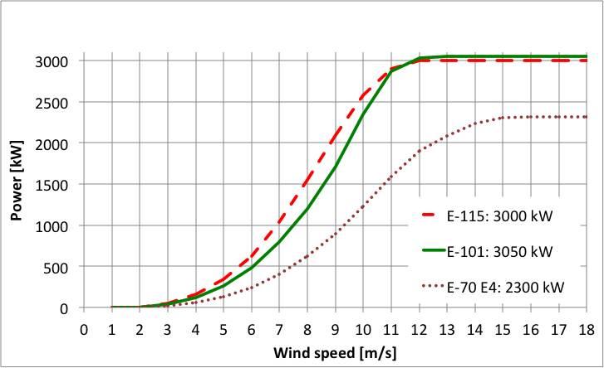
Effect of poor C_{p} on power curves

Slide 28
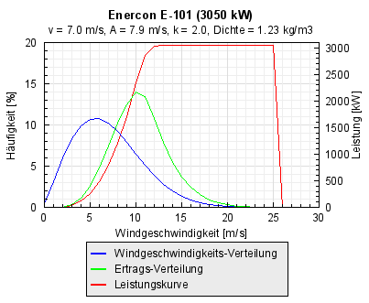
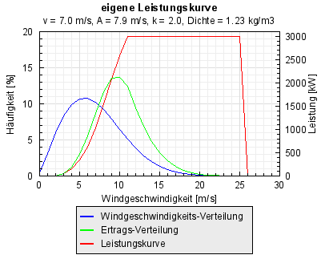
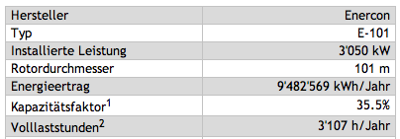
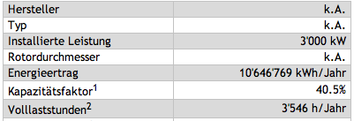
Effect on energy yield (E-115 vs. E-101) (+12% AEP from 31% larger swept area at v_{ave} = 7 m/s)
Enercon E-115 (3000 kW)
Enercon E-115 (3000 kW)
115 m

Slide 29
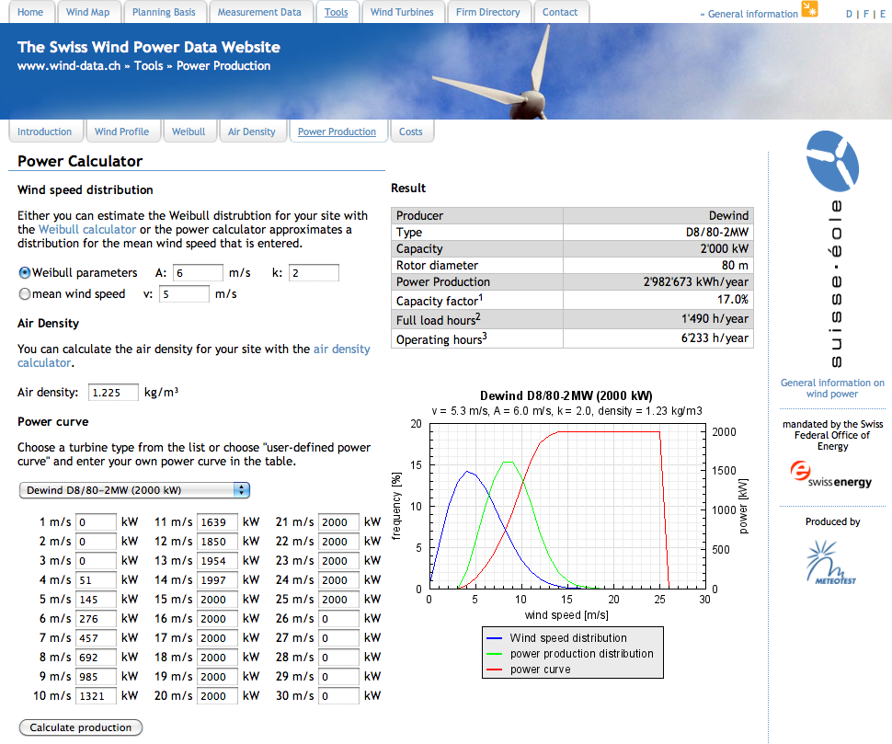
http://wind-data.ch/tools/powercalc.php?lng=en

Slide 30
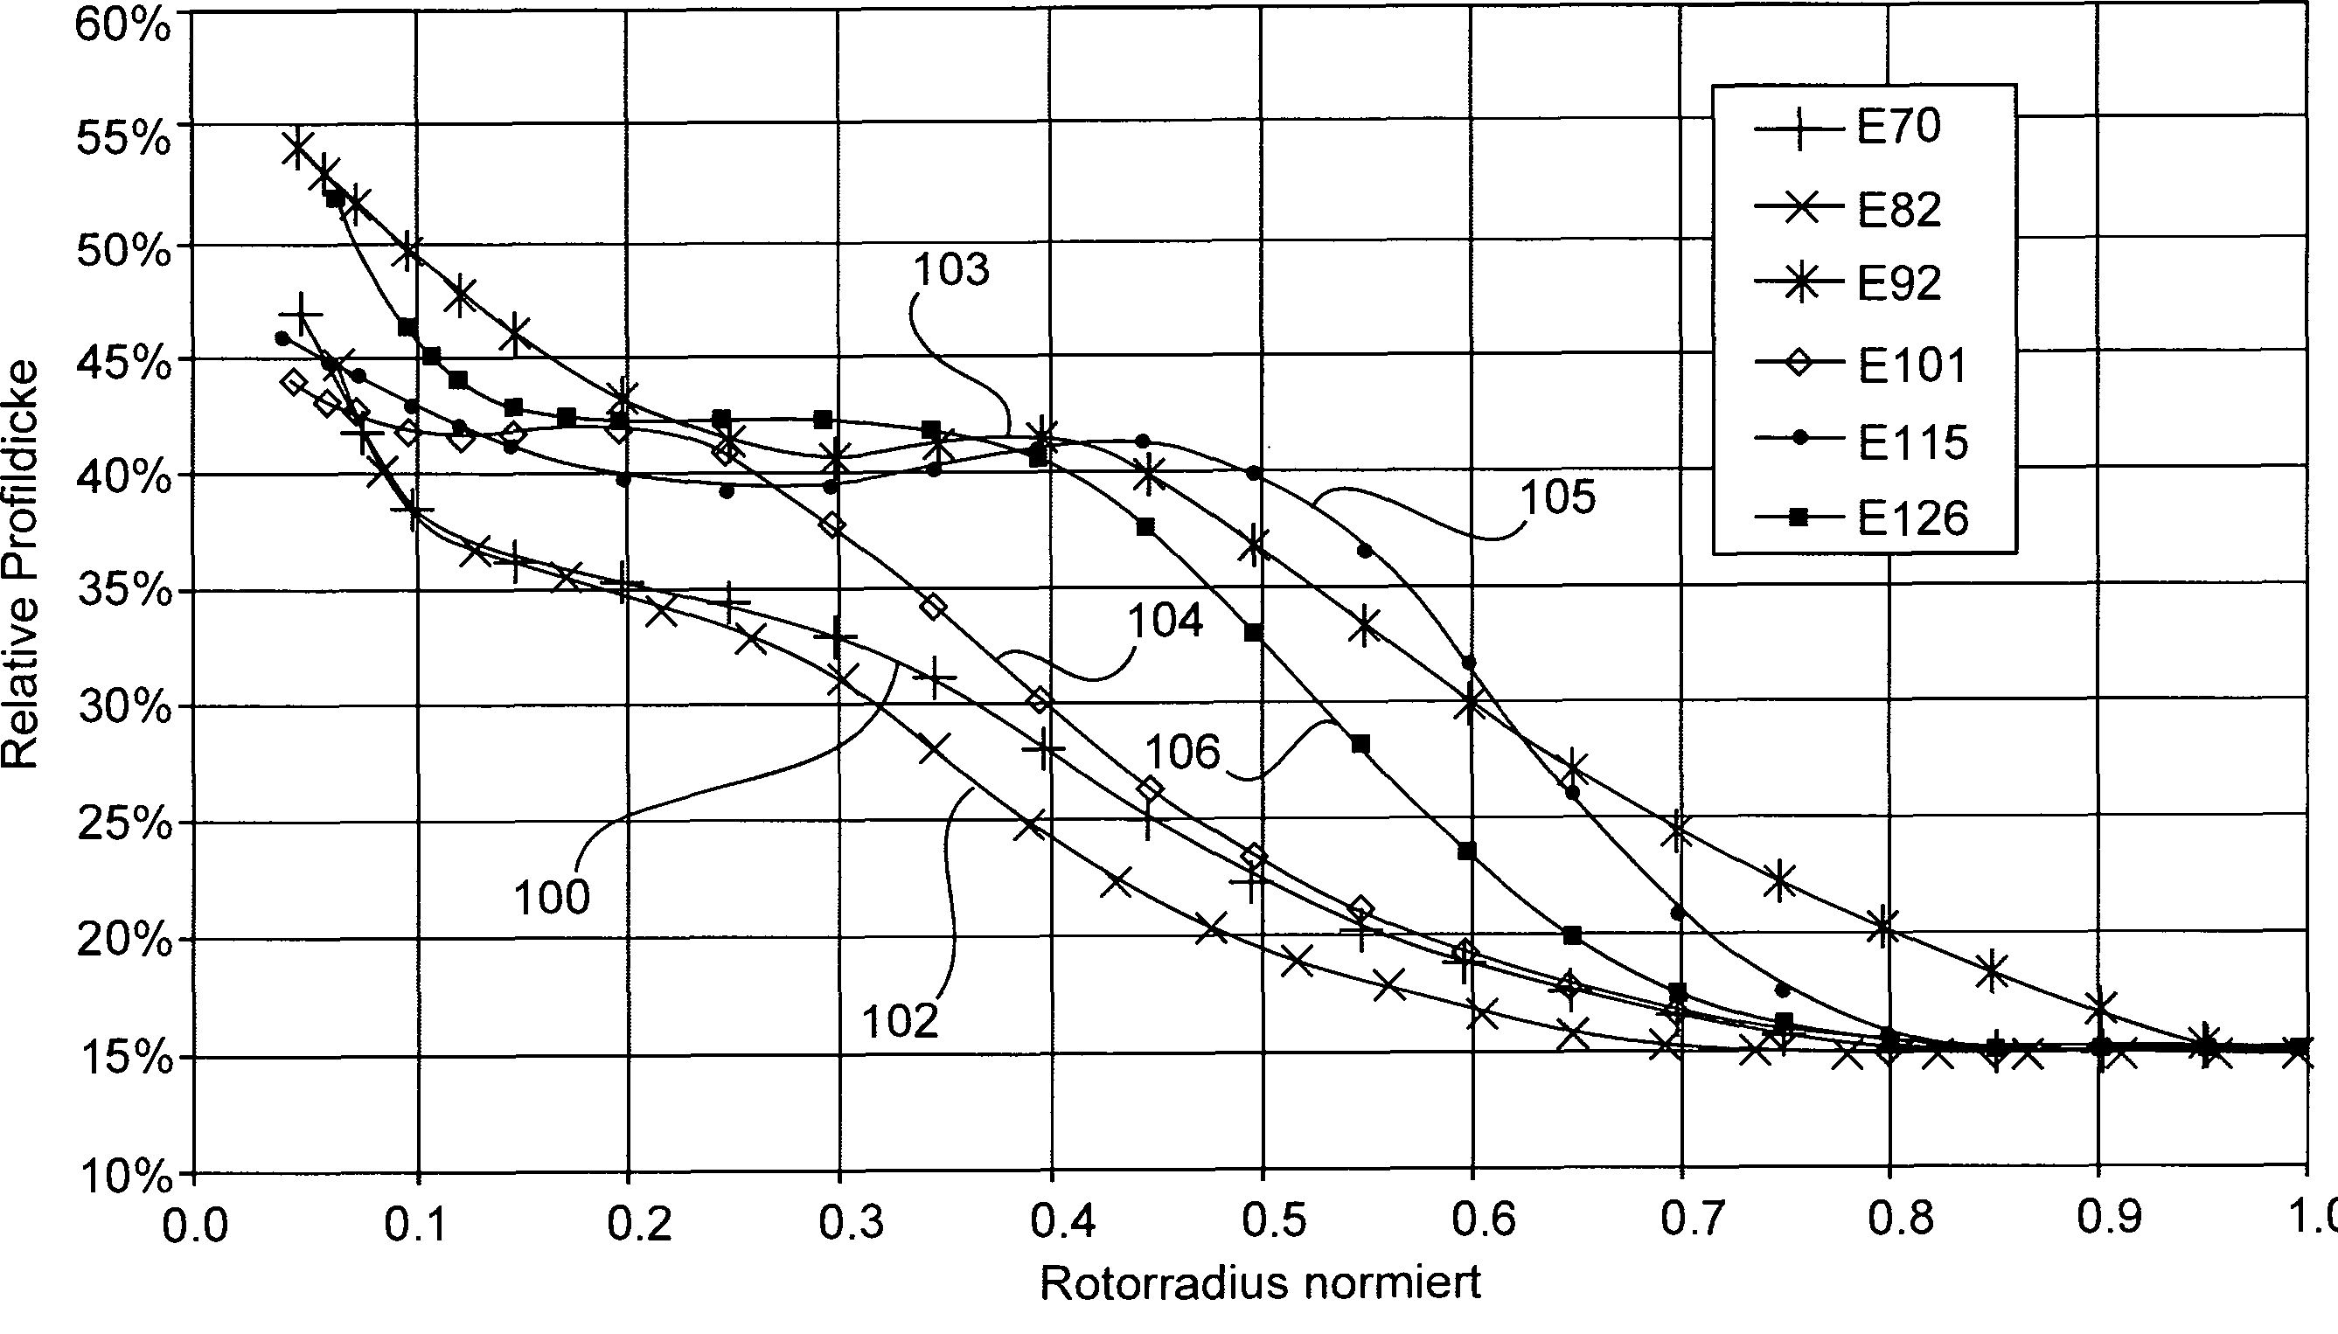
Distribution of relative blade thickness along the blade span

Slide 31
Overview
Blade design (Betz)
Blade design (Schmitz)
Implementation in NREL codes
Blade design for recent variable speed turbines

Slide 32
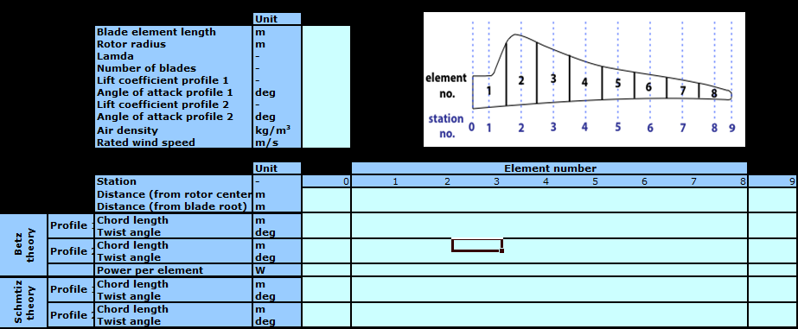
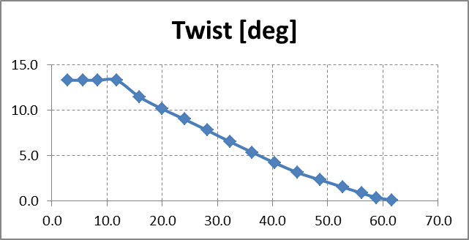
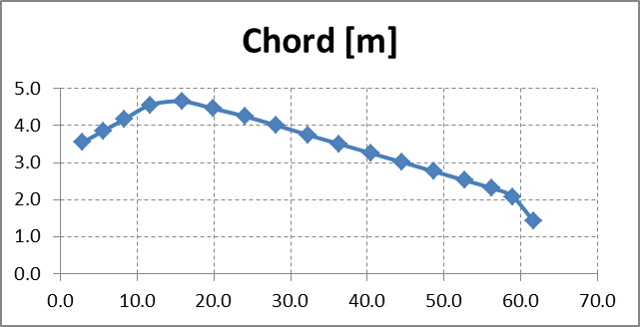
Complete rotor design
Open tab „Blade_geometry“ of „CIP_01_DoWES.Rotor_design_start_parameter.SS2014.01.xlsx“
Calculate blade properties
Verify twist and chord distribution
1
2
3

Slide 33
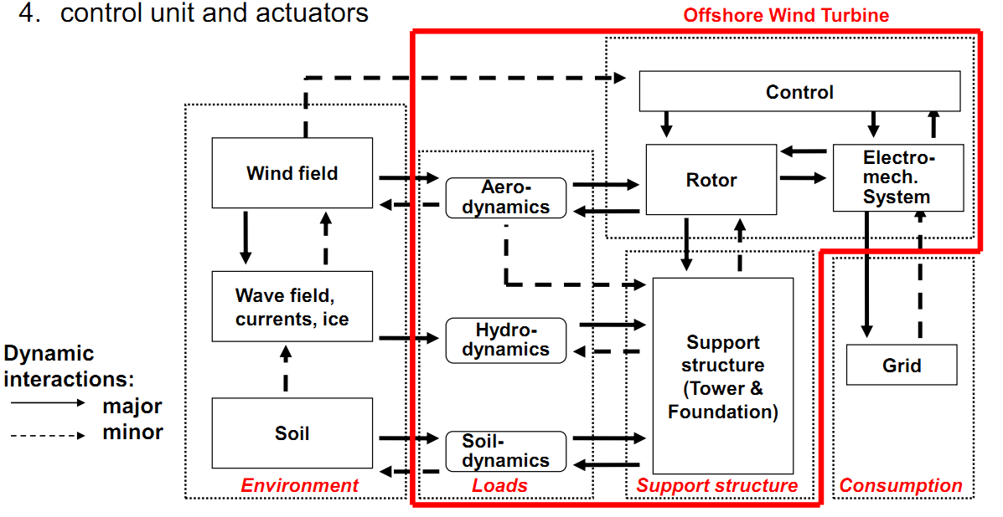
Simulation – Several modules

Slide 34
Simulation – Onshore
Onshore wind turbine

Slide 35
Simulation – AeroDyn
See manuals:
“AeroDyn_UserGuide.pdf”
“AeroDyn_Theory.pdf “
Onshore wind turbine
FAST
TurbSim
AeroDyn

Slide 36
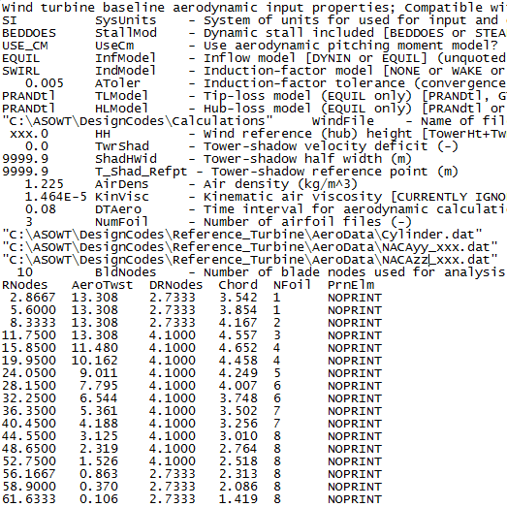
Aerodynamics – Input file for AeroDyn
1
Rename input file „Blade_Color_Aero.ipt“ with the „color“ of your turbine (example: blue, green, red, etc.)
Open renamed file & inspect information:
2

Slide 37
Aerodynamics – Input file for AeroDyn
1
Rename input file „Blade_Color_Aero.ipt“ with the „color“ of your turbine (example: blue, green, red, etc.)
Open renamed file & inspect information:
aerodynamic calculation
turbulent wind field file
Hub height & air properties
Airfoil files & blade geometry
2

Slide 38
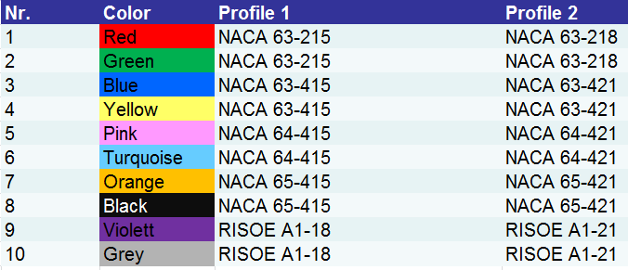
Aerodynamics – Blade design

Slide 39
Aerodynamics – Update AeroDyn
Write hub-height
Complete name & path of airfoils: „NACAyy_xxx“, „RISOExx_yy“
Enter rotor blade definition:
RNodes – distance from root
AeroTwist – twist angle
DRNodes – element length
Chord – chord length
Check „AeroDyn_UserGuide.pdf“
3
4
5

Slide 40
Summary / Conclusion
We designed our own blades with respect to the given start parameters
Results: blade planform and twist for Betz and Schmitz design methodology

Slide 41
Reserve: --- no pdf, don‘t print ---

Slide 42

1. Introduction to CIP Tutorials
Main parameters
Load analysis
Rotor design
Turbine dynamics
Characteristic curves
External conditions

Slide 43
Groups
Nr. | Color | Student 1 | Student 2
1 | Red
2 | Green
3 | Blue
4 | Yellow
5 | Pink
6 | Turquoise
7 | Orange
8 | Black
9 | Violett
10 | Grey

